Slide 1


CAPSTONE PROJECT
3D Printer
Presented By:
1. R.Rajeshwarma-Solamalai College of Engineering-Mechanical Engineering

Slide 2
OUTLINE
○
Probelm Statement
Proposed Solution
System Approach
Algorithm & Deployment
Result
Conclusion
Future Scope
References
○ ○ ○ ○
○
○ ○

Slide 3
PROBLEM STATEMENT
This dataset comes from research by Mechanical Engineering department.
The aim of the study is to determine how much of the adjustment parameters in 3d printers affect the print quality, accuracy and strenght. Where there are nine setting parameters and three measured output parameters.

Slide 4
PROPOSED SOLUTION
Setting Parameters:
Layer Height (mm)
Wall Thickness (mm)
Infill Density (%)
Infill Pattern ()
Nozzle Temperature (Cº)
Bed Temperature (Cº)
Print Speed (mm/s)
Material ()
Fan Speed (%)
Output Parameters: (Measured)
Roughness (µm)
Tension (ultimate) Strenght (MPa)
Elongation (%)

Slide 5
SYSTEM APPROACH
Building the proposed solution would involve a combination of data processing,feature engineering,and machine learning. Here are the key system and library requriements.
System Requirements:
1.Hardaware:
A computer with sufficent processing power,perferably wwith multiple cores or a GPU for faster traning of machine learning models.
Adequate RAm to handke the size of the saraset and computational requriments.
2. Software:
An operating syatem compatible with the requrired machine learning libraries(eg., Windowa=s, linux,macsOS).

Slide 6
ALGORITHM & DEPLOYMENT
K-Nearest Neighbors (KNN) algorithm
The K-Nearest Neighbors (KNN) algorithm is a popular machine learning technique used for classification and regression tasks. It relies on the idea that similar data points tend to have similar labels or values. During the training phase, the KNN algorithm stores the entire training dataset as a reference.
Steps to implement the K-NN algorithm:
Data Pre-processing step
Fitting the K-NN algorithm to the Training set
Predicting the test result
Test accuracy of the result(Creation of Confusion matrix)
Visualizing the test set result.

Slide 7
ALGORITHM & DEPLOYMENT
Deep neural networks (DNN)
Deep neural networks (DNN) is a class of machine learning algorithms similar to the artificial neural network and aims to mimic the information processing of the brain.
Steps to implement the DNN algorithm:
Data collection
Feature extraction
Information processing
Model training
Performance evaluation

Slide 8
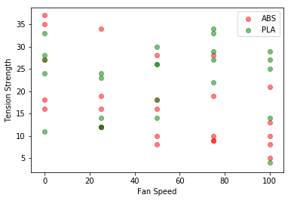
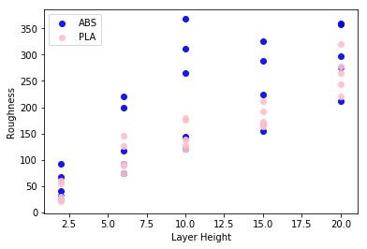
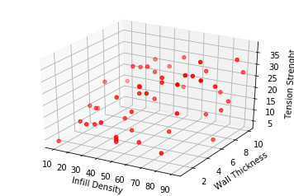
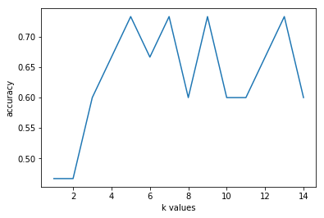
RESULT

Slide 9
CONCLUSION
This work is based on the Ultimaker S5 3-D printer settings and filaments. Material and strength tests were carried out on a Sincotec GMBH tester capable of pulling 20 kN.
Here we try to estimate which material is used from the input and output parameters using the kNN and DNN algorithms.

Slide 10
FUTURE SCOPE
The future of 3D printing is bright, promising faster, more diverse, and more integrated production methods. By embracing these trends and prioritizing quality, security, and sustainability, this technology can revolutionize manufacturing and empower businesses to create a more resilient and responsible future.

Slide 11
REFERENCES
https://www.kaggle.com/datasets/afumetto/3dprinter

Slide 12
THANK YOU

